Slide 1
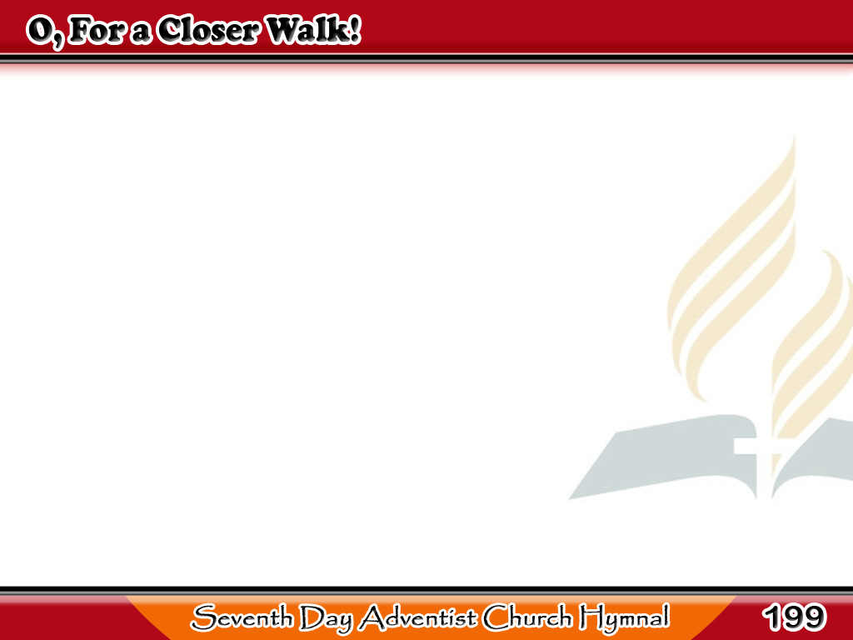
Upang Malapit sa Diyos
O, for a closer walk with God!
A calm and heavenly frame,
A light to shine upon the road
That leads me to the Lamb.
1/4

Slide 2
Upang Malapit sa Diyos
Return, O holy Dove! return,
Sweet messenger of rest;
I hate the sins
that made Thee mourn,
And drove Thee from my breast.
2/4

Slide 3
Upang Malapit sa Diyos
What peaceful hours
I once enjoyed!
How sweet their memory still!
But they have left an aching void
The world can never fill.
3/4

Slide 4
Upang Malapit sa Diyos
The dearest idol I have known,
Whate’er that idol be,
Help me to tear it
from Thy throne,
And worship only Thee.
4/4

